Slide 1


UX RESEARCH ANALYSIS
[PROJECT TITLE]
[SUBTITLE GOES HERE]
[AUTHORS] [YEAR/DATE]

Slide 2


SECTION
[SECTION NAME]

Slide 3


[GRAPH TITLE]

Slide 4



[COMPARISON TITLE]

Slide 5
[STATISTICAL DATA TABLE]
Metric | Deliveroo (Avg) | Glovo (Avg) | p-value | Significance
Task Success Rate | 92% | 85% | 0.042 | Significant
Time on Task (s) | 45.2 | 58.1 | 0.001 | High
SUS Score | 78.5 | 72.1 | 0.125 | Not Significant
Error Rate | 0.5 | 1.2 | 0.033 | Significant
[TABLE FOOTNOTE: Results based on Mann-Whitney U Test]

Slide 6


KEY FINDINGS & INSIGHTS
Finding 1: [REPLACE WITH KEY INSIGHT GENERATED BY PYTHON ANALYSIS]
Finding 2: [REPLACE WITH KEY INSIGHT GENERATED BY PYTHON ANALYSIS]
Finding 3: [REPLACE WITH KEY INSIGHT GENERATED BY PYTHON ANALYSIS]
Finding 4: [REPLACE WITH KEY INSIGHT GENERATED BY PYTHON ANALYSIS]

Slide 7

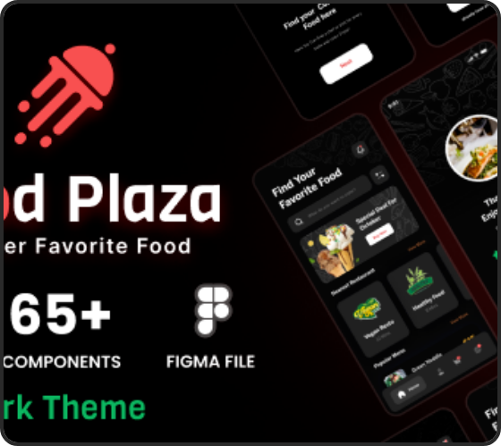

[TASK NAME: E.G. SEARCH RESTAURANT]
TASK DESCRIPTION
[DESCRIPTION: "User is asked to find a Poke restaurant with a rating higher than 4.5 and a delivery fee under 2€"]
TASK RESULTS
SUCCESS RATE
AVG TIME
[XX%]
[XX.X s]

Slide 8


[QUESTION TITLE: UEQ SCALE]
3.2
0.8
1.5
4.9
MEAN
STD DEV
MIN
MAX

Slide 9




FINAL VERDICT & CONCLUSIONS
DELIVEROO
GLOVO
[STRENGTH 1]
[STRENGTH 1]
[STRENGTH 2]
[STRENGTH 2]
[WEAKNESS]
[WEAKNESS]

Slide 10

IMAGE SOURCES
https://s3.envato.com/files/390502005/01_Preview.__large_preview.png
Source: themeforest.net

